Slide 1
Lecture 17b:
4.6b. Underdevelopment and Empire
Brad DeLong
Department of Economics & Blum Center, U.C. Berkeley; & WCEG
last revised: Mo 2020-03-26
for presentation: Th 2020-03-31
Original course by Melissa Dell (Harvard Econ 1342), revised by Brad DeLong
<https://github.com/braddelong/public-files/blob/master/econ-135-lecture-17.pptx>
<https://www.icloud.com/keynote/0lWeNgJnwEjyoHm3Gf81hWJXw>

Slide 2
Big Ideas: Lecture 16: Inequality and Plutocracy
Takeaways from last lecture:
Give me five…

Slide 3
Discussion
The Development of Underdevelopment:
What strikes you as important here?

Slide 4

The Watershed: 1870 as the Inflection Point
As of 1870, had the Industrial Revolution raised the standard of living or lightened the toil of the working class in England, the country at its center?
No.
Why not? Malthusian forces—population explosion & thus smaller farm sizes.
Pace of technological and organizational change not fast enough to raise incomes high enough to force the demographic transition.
Hence importance of 1870: our h goes from 0.44%/yr to 2.06%/year, globally, and sticks there since
(Until now?)
Principal cause of the speed-up? The modern corporation and its industrial research labs that made routine the process of developing and then implementing new productive ideas.
(Was this baked in the cake by the Industrial Revolution? Or could this have been bobbled?)
Assisting: globalization:
Globalization of goods through trade using railroads and iron-hulled steamships
Globalization of people through migration using railroads and iron-hulled steamships
Globalization of communications using the telegraph
Yet: DIVERGENCE, BIGTIME
4:00
Notes:
The Watershed: 1870 as the Inflection Point
As of 1870, had the British Industrial Revolution raised the standard of living or lightened the toil of the working class in England, the country at its center? No. Why not? Because of Malthusian forces—a population explosion & thus smaller farm sizes would result from any improvement in human technological knowledge about the control of nature and the organization of humans. The smaller farm sizes produced by larger populations would reduce productivity. Thus while human technological knowledge capital-H would increase and could increase significantly, human labor efficiency capital-E would not. And the pace of technological and organizational change not fast. Not fast enough to raise incomes high enough to force the demographic transition, and break the mold of this Malthusian system.
From this comes the permanent world-historical importance of 1870: Around the year 1870—in the generation between 1860 and 1880—our worldwide lower case-h proportional rate of growth in the value of the stock of useful human technological knowledge about the control of nature and the organization of humans.goes from 0.44%/yr to 2.06%/year. And there it sticks—until, possibly, this rate of growth drops off, starting now. (But that is the subject for another time.)
The principal cause of this speed-up? The coming of the modern industrial research lab and the growth of the STEM labor force that made the process of creating, developing, and then providing proof-of-concept of new productive technological ideas a routine and routinized and rationaalized one. Plus the coming of the modern corporation that made the process of deploying new technological ideas on a global scale a routine and routinized and rationalized one.
Was the growth of the STEM labor force, the development of the industrial research lab, and the coming of the modern corporation inevitable—baked in the cake—as a result of what went down during the 1770-1870 British Industrial Revolution era? Or might the path to this circa-1870 economic-engineering-technological breakthrough have been missed? This is a deep question that we do not have good answers to. I tend to say that it was not baked in the cake, at least not by anything that happened in the first two-thirds 1770-1840 of the British Industrial Revolution century. Why do I think this? Because arguments that it was baked in the cake tend, I think, to lead us to have expected another couple or more of speed-ups in lower case-h since. And we have not had such.
But assisting the STEM-lab-corporation trio in discontinuously and substantially boosting lower case-h was globalization:
* Globalization of goods through trade ,using railroads and iron-hulled steamships
* Globalization of people through migration, using railroads and iron-hulled steamships
* Globalization of communications, using the telegraph
Yet, somehow, at least the first century of the post-1870 Modern Economic Growth era has also seen DIVERGENCE, BIGTIME. While economic and political-economic processes have seen the global north develop massively, they have also seen the emergence of enormous income and productivity gaps between the global north and the global south. While the global north has been developed, the global south has been underdeveloped—has grasp of a lot smaller a fraction of the human technological cornucopia H than it had hold of in 1870, or, indeed, at any time earlier.

Slide 5
The Economic El Dorado of 1870-1914
Or so John Maynard Keynes called it in his The Economic Consequences of the Peace, looking back from 1919:
In heavy industries the global north in 1914 was remarkably modern
In 1913 Britain burned 194 million tons of coal. Total coal-equivalent energy consumption of Britain today less than 3x 1913
Average U.S. passenger RR mileage in 1913: 350/person. Average U.S. airline miles today: 3000/person
In other ways, even the global north poor and premodern:
Agriculture largely unmechanized
More than half of Americans still working on the farm
Only Britain and Belgium with less than half of the labor force in agriculture
Nitrogen artificial fertilizers just coming on line
People still worked like dogs in the South Pacific to mine the products of avian defecation off of islands offshore of Chile—and then ship the guano back to Europe as fertilizer
Social and political dominance of landlord-aristocrats.
3:30
Notes:
The jump in lower case-h from 0.44%/year to 2.06%/year around 1870 meant that the next half-century—the years before World War I began in 1914—were, as John Maynard Keynes, looking back from 1919, called it in his The Economic Consequences of the Peace, an economic El Dorado: a previously unseen and unimagined epoch of expansion in global wealth and prosperity, visible nearly everywhere all over the globe.
And as a result, in same ways that world economy as it stood in 1914 on the eve of World War I was remarkably modern. This was true in heavy industries, especially. In 1913 Britain burned 194 million tons of coal. Total coal-equivalent energy consumption of Britain less is less than three times as large. Average U.S. passenger railroad mileage in 1913 was 350 miles/person. The average American thus spent ten hours on a train getting someplace at a distance and at a speed beyond the wildest imaginings of previous centuries, save for miracle tales like the one in which an angel carries the Prophet Habbukuk by the hair from Jerusalem to Babylon to feed the Prophet Daniel a bowl of stew he had just cooked. Today average U.S. airline miles per year are 3000/person. Today we travel ten times as fast and ten times as far on average, but the quantum gap is between 1800 and 1914, not beween 1914 and today.
In other ways, however, even the global north was desperately poor and premodern, even in the most advanced parts. Agriculture, even in North America, was still largely unmechanized: more than half of Americans still working on the farm. Only Britain and Belgium had less than half of the labor force in agriculture, and that was not because their food was grown via mechanized agriculture, but because their manufacturing exports allowed them to have the farmers who grew by hand the crops that fed them be located in other parts of the world with more abundant and better land.
Remember, in the years before World War I, nitrogen artificial fertilizers were just coming on line. People still worked like dogs in the South Pacific to mine the products of avian defecation off of islands offshore of Chile and Peru—and then ship the guano back to Europe as fertilizer. “Guano King” was an occupation and description of more than one plutocrat in those days.
And 1914 still saw, throughout all of the globe save the recent-European-settlement English-speaking lands of Australia, New Zealand, Canada, and the United States, the remarkably thorough political dominance of landlord-aristocrats:
* people who feared being creatively destroyed by economic, political, and sociological change;
* people who had lost or who were rapidly losing any claim to performing a valuable social role;
* people who were then remarkably eager to stoke the flames of nationalism and roll the dice of war, in order to “busy giddy minds with foreign quarrels” and so distract the thoughts of those they wanted to have remain their underlings from ideas like “socialism”, “progressive taxation”, and “expanded government provision of commodities”.

Slide 6
Trade
Flour cost 1.5 cents/lb in Chicago and 3 cents/lb in London in 1840; by 1870 it was 1.5 and 2.0
A fall in the London price of a 2 lb. loaf of bred from an hour to 40 minutes of unskilled labor time
A 2/3 fall in transport cost
Railroads
1900: 12,000 miles of railroads in Africa, 38,000 miles in Asia, and 26,000 miles in South America
1930: 40,000 miles of railroads in Africa, 80,000 miles in Asia, and 60,000 miles in South America
Everyplace in the world—as long as there was a dock and a RR linking it—became cheek-by-jowl with everyplace else for all commodities save the fragile and the spoilable
The North Atlantic’s comparative advantage in making manufactured goods became overwhelmingly important
International trade as a proportion of world population: 1.5% in 1500, 3% in 1700, 4% in 1850, 11% in 1880, 17% in 1913, 30% today

Slide 7
Other Factors
Seven stand out:
Population explosion
Global reach of investment
Demographic transition
Feminist revolution
One world story
World conquest
Escalator to modernity

Slide 8
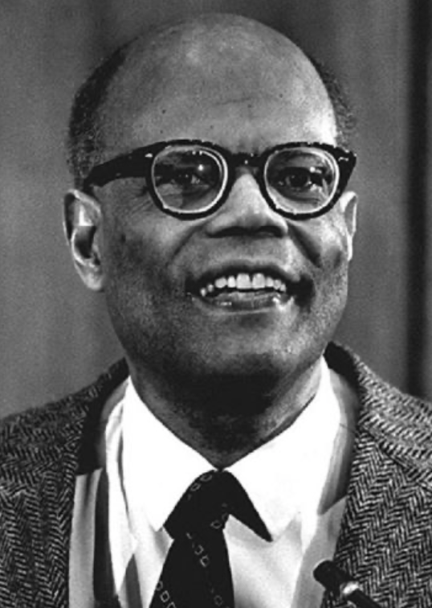
The Last Acceleration
The industrial research lab to routinize invention, and the modern corporation to routinize diffusion and deployment
Plus general purpose technologies—machine tools, non-human power sources
Arthur Lewis:
“New commodities: telephones, gramophones, typewriters, cameras, automobiles, and so on, a seemingly endless process whose latest twentieth-century additions include aeroplanes, radios, refrigerators, washing machines, television sets, and pleasure boats. Thus a rich man in 1870 did not possess anything that a rich man of 1770 had not possessed; he might have more or larger houses, more clothes, more pictures, more horses and carriages, or more furniture than say a school teacher possessed, but as likely as not his riches were displayed in the number of servants whom he employed rather than in his personal use of commodities…”
Not so much the particular technologies, as the grasping of the fact that there was a broad and deep range of new technologies to be discovered.
As much as it was new technologies, it was large-scale corporate organizations that could and did plan the division of labor to make use of and then market technologies.
And as much, it was that the global market meant that there was now a great deal of money to be made from the routinization of the exploration, development, and deployment of technological possibilities

Slide 9
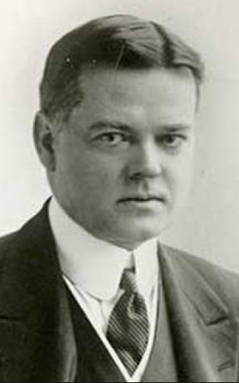
Herbert Hoover
Born in 1874 in Iowa. Father a blacksmith. Orphaned at 10:
Farmed out to be raised in Oregon by an uncle and aunt
First student to attend Stanford University (then free)
Graduating in 1895 in the distressed aftermath of the Panic of 1893
Became a mining engineer.
First job was as a mine laborer in Grass Valley, at 600 dollars a year.
In today’s dollars, $9/hr—but same relative income as $80/hour today
multiples of x30, x8 for inflation and real income growth
Next was as an intern and special assistant to mining engineer Louis Janin at 2400 dollars a year.

Slide 10
Herbert Hoover II
Globalization and Imperialism!
Then in 1897 he crossed the Pacific to first Australia, working first for Bewick, Moreing for 7000 dollars a year
Then to China, working at 20,000 a year and up:
Somehow wound up with Kaiping Coal Mine
Told 2 stories:
Rescued shareholders from corrupt Chang Yenmao
Played it straight with Chang Yenmao, but then was betrayed by Belgian financiers
1901-1917 his base was London, as he worked in and managed investments in Australia, China, Russia, Burma, Italy, and Central America in addition to the United States.
WWI aid to Belgium as an NGO
In 1917 he moved back to America.
Post-war famine relief
Secretary of Commerce in 1924
Elected president in 1928.
From orphaned son of the town blacksmith to college graduate to multimillionaire mining consultant to elected President of the United States in 1928—could anyone’s ascent have been so fast and so far anywhere else? Was anyone else’s ascent so far and so fast even in America?

Slide 11
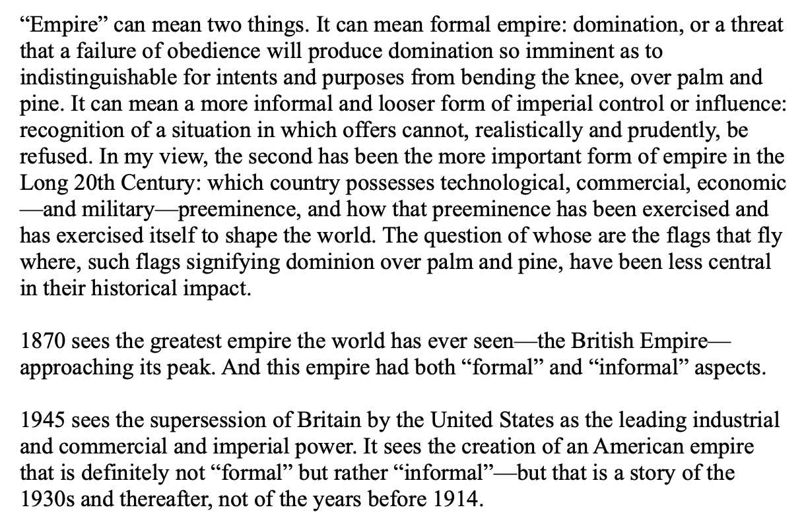
20th Century Empires
Huge but “loose”:

Slide 12
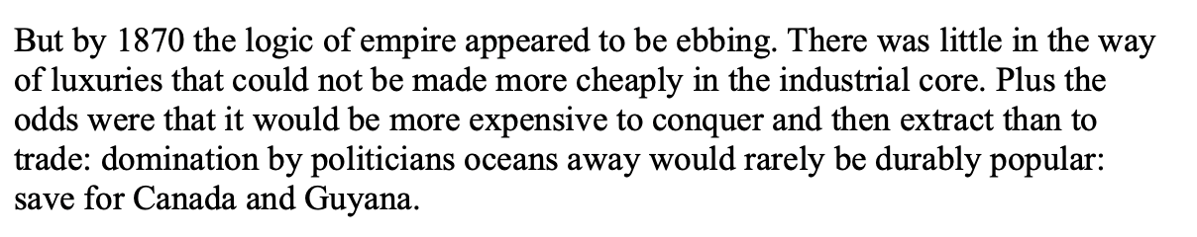
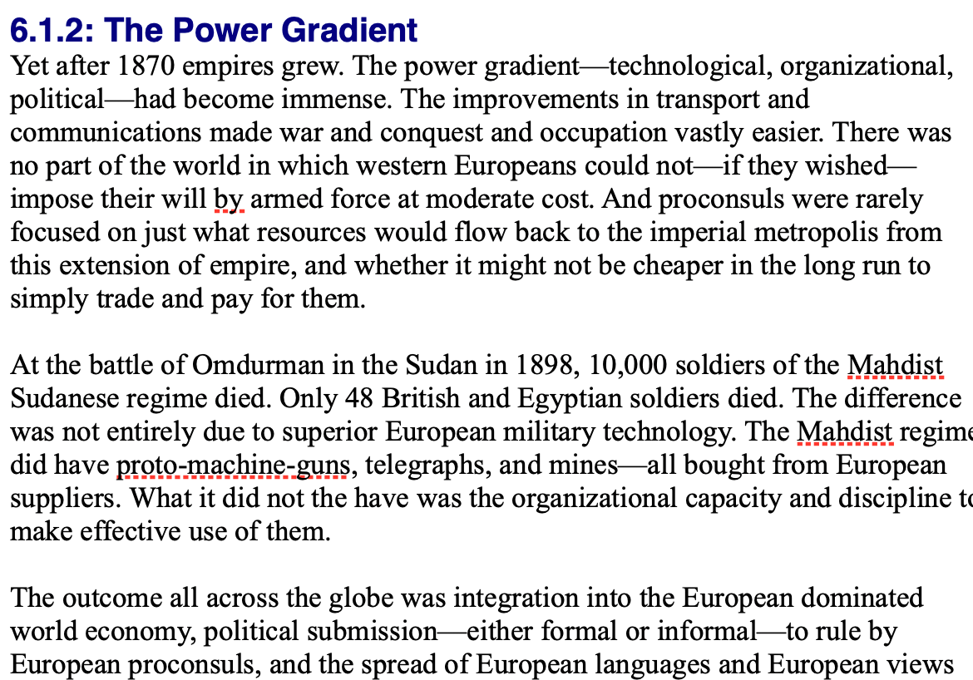
By 1810 the Tide of Empire Was Clearly Ebbing…
But things turn around: the power gradient

Slide 13
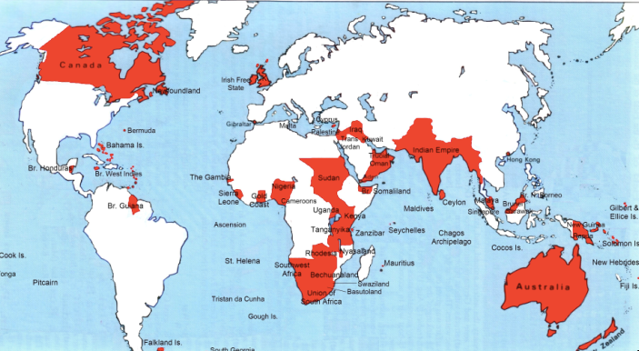
Empire

Slide 14
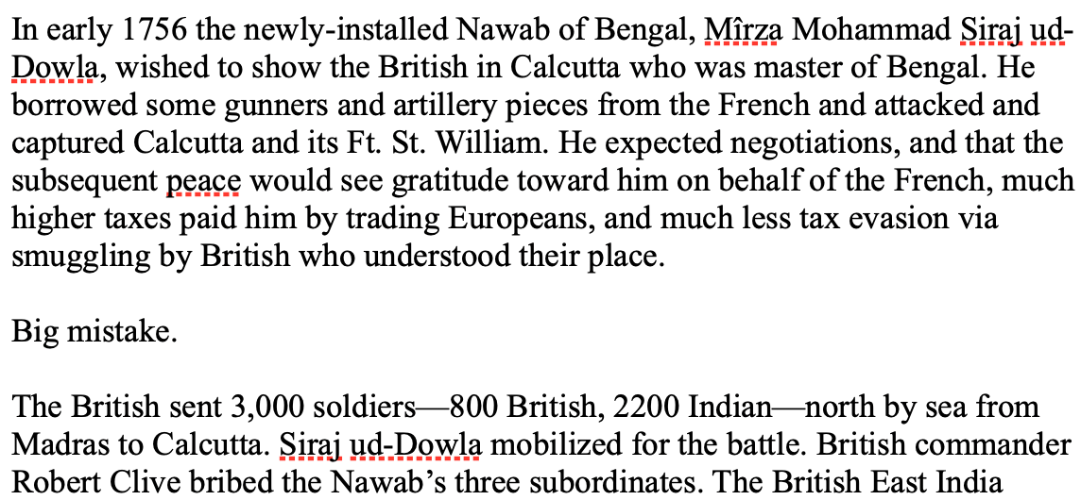
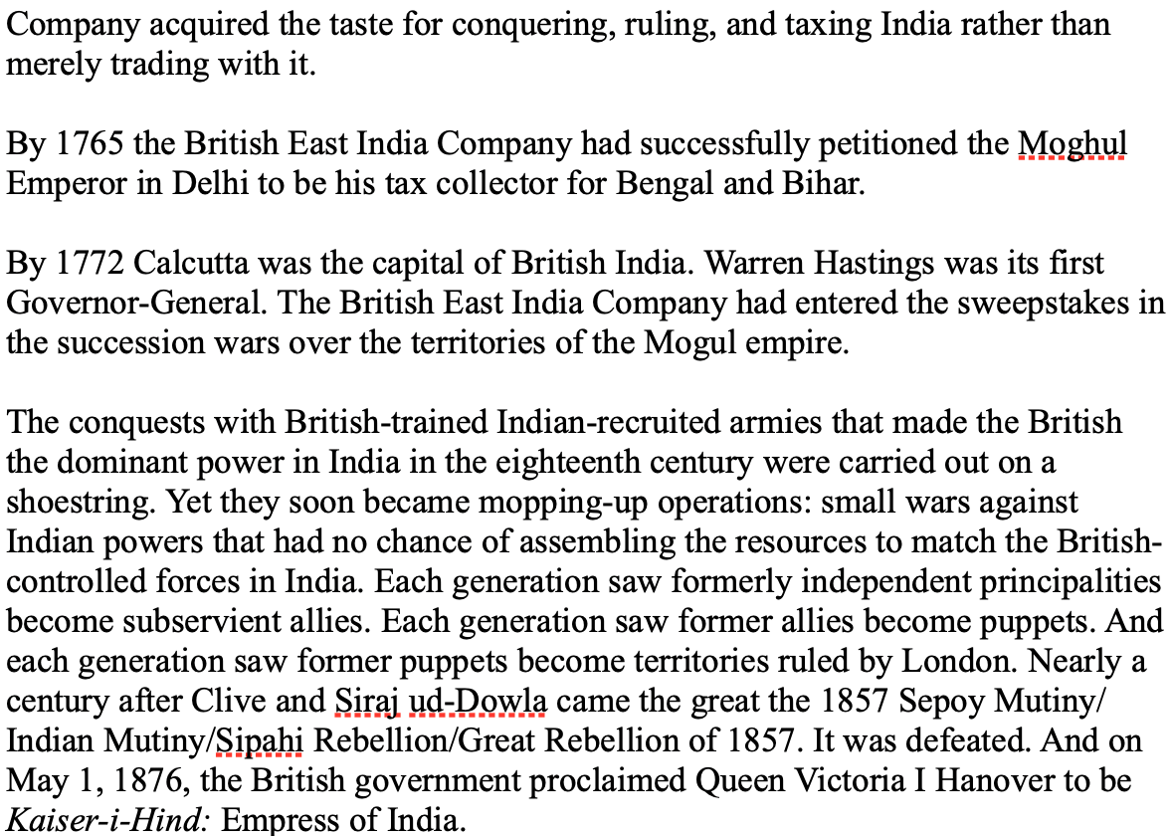
India
How do the British manage to conquer India?

Slide 15
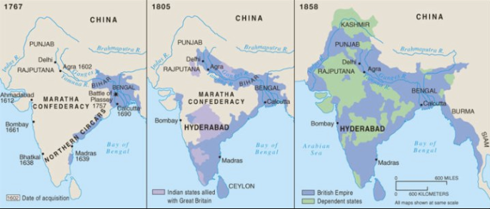
The Conquest of India
1767: Bombay, Madras, Calcutta, and tax collector for the collapsing Mogul Empire in Bengal and Oudh
1805: armies composed 3/4 of soldiers born in India; Viceroy Richard Wellesley’s conquest policy
1858: conquest complete with suppression of Sipahi Uprising

Slide 16
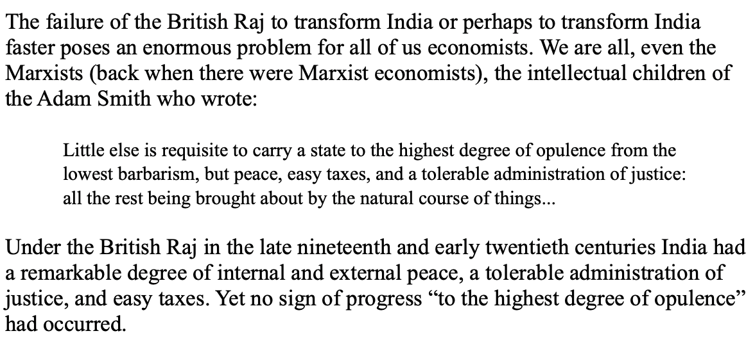
India
Why didn’t the British transform India into an industrial power?

Slide 17
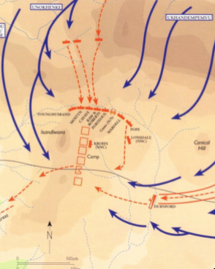
Isandlhwana
1879
Sir Henry Bartle Freer, High Commissioner for South Africa
His mandate: to “Canadaize” it…
Cape Colony
Natal
Boer Republics
Zululand
Lord Chelmsford with 15000 soldiers
The “horns and chest of the buffalo”
1300 British casualties—1300? Zulu
British reaction: “We can’t be beaten by n———“
As Cetshwayo had feared…

Slide 18
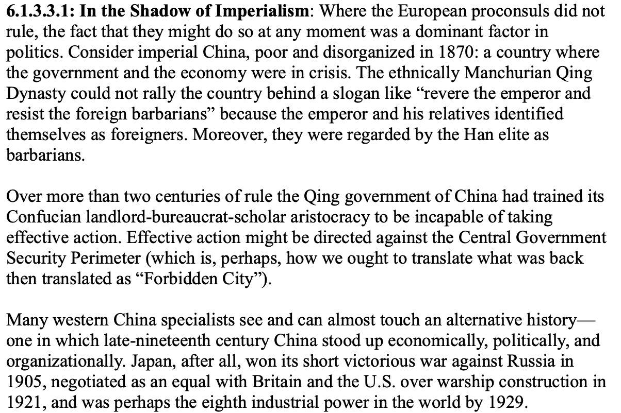
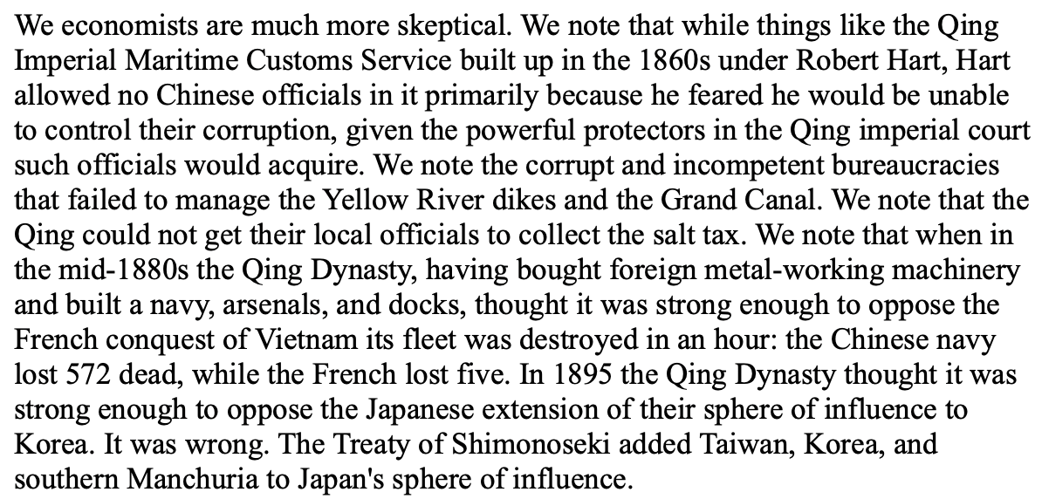
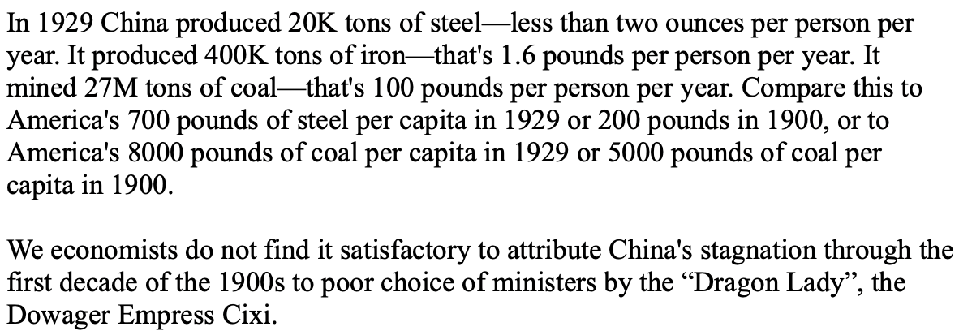
China
Why did 1870-1975 see China’s relative nadir?

Slide 19
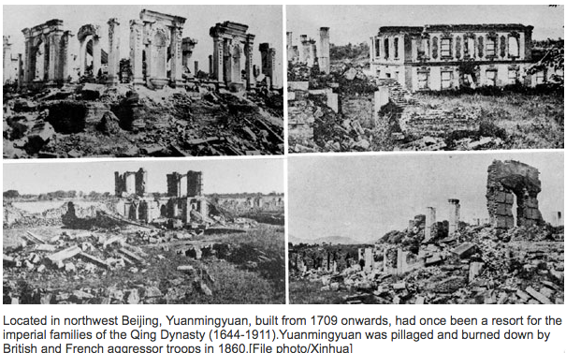
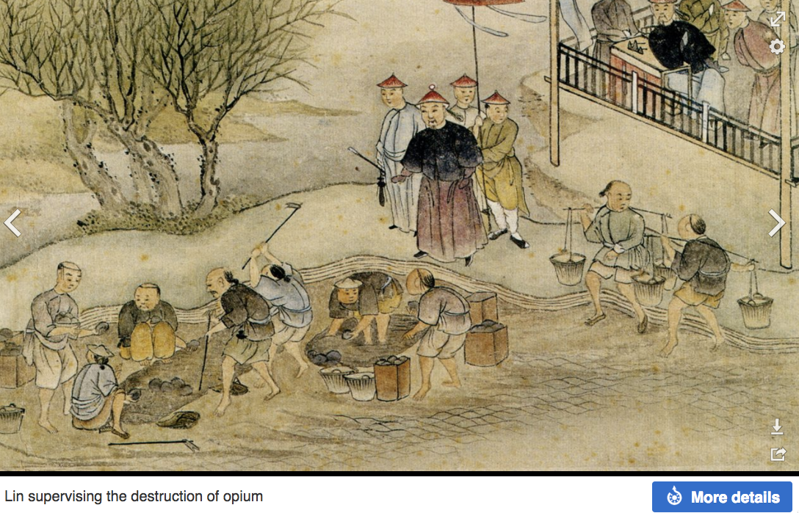
“Self-Strengthening”
The puzzle of China vs. Japan
Great Qing (大清)(1644-1912)
Wu Sangui (吳三桂)
The Rebellion of the Three Feudatories (三藩之亂)
Kangxi and Qianlong: “revere the emperor and expel the barbarians” is difficult to pursue when the emperor and his clan identify themselves as “barbarians”
Tai-Ping Rebellion (太平天國運動)
Cixi ( 慈禧太后)

Slide 20
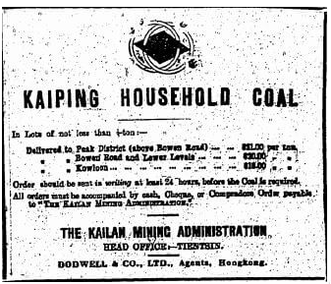
“Self-Strengthening” II
Li Hongzhang (李鴻章) and the Kai-Ping coal mine…
From 1881…
Build up an industrial base…
Opposition…
Chang Yen-Mao
Bannerman
“Boxers” (义和拳)
Herbert Hoover
Chang Yen-Mao vs. Moreing…
Li Hongzhang (李鴻章) “did not have the reputation for financial disinterest enjoyed by his patron Zeng Guofan (曾国藩)”

Slide 21
Formal Empires
There were, broadly, three views as to why European late-1800s empires rose to such domination, each of which with its own view of what was to be done to fix the situation:
One view is that of John Hobson: The major economic problem was the business cycle. Equipping the military needed to maintain the empire puts people to work. And an empire is a good source of consumers for the products of domestic factories. European governments that pursued empire, Hobson thought, were less likely to face economic distress and so more likely to continue in office.
A second view was that of Joseph Schumpeter: imperialism as the last gasp of military status aristocracy.
The third view was that empires were ordained by God—or at least morally required or desirable, for European powers had a civilizing mission. The Europeans were lucky enough to be the grownups, and it was the obligation of the grownups to civilize the world. But perhaps civilization is best spread by newspapers and books and merchants and engineers, rather than by alien proconsuls? Just a thought.

Slide 22
Informal Empires
But even where Britain (or France, or Germany, or Portugal, or Spain, or those who thought of themselves as descended from the conquistadores of Castile, or Anglo-Saxon settlers) did not rule, they reigned:
Britain seemed successful: playing by Britain’s rules seemed wise…
Britain was powerful: playing by Britain’s rules seemed likely to keep it from getting annoyed…
Britain was working very hard to make itself attractive—to make becoming a Briton-by-proxy of some sort straightforward and profitable in both money and cultural terms…
Britain was the first-mover hegemon: international cooperation was on its terms…

Slide 23
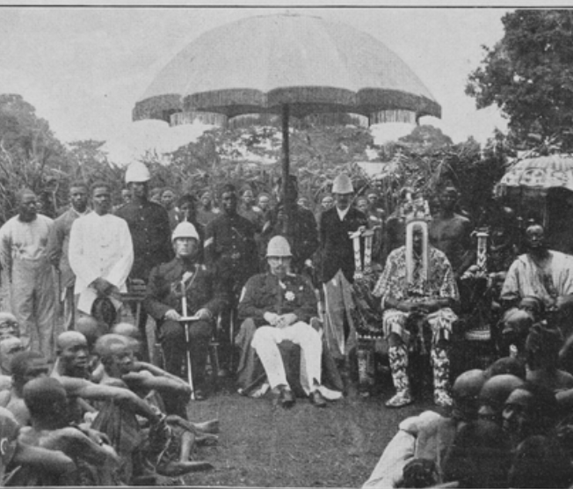
The Colonized Experience
The standard package for successful development;
Market-promoting government;
Building railroads, canals and ports;
Chartering banks for commerce and investment;
Establishing mass education
Imposing smart tariffs on those manufactured imports that would in the short-run crowd out production and thus the creation of the communities of engineering practice
Colonial masters would not allow the standard package
Neverthless, progress:
Even outside of the global north the world was far richer in 1950 than it had been in 1800
The center-of-gravity of what now is the global south was at a living standard of $2 a day in 1800s
$2.25 by 1870
$3.50 by 1913.
But still about $3.50 by 1950.
However, there were a number of economies that seemed to be taking advantage of opportunities:
Japan
Those parts of Latin America that escaped internal colonization by landed and bureaucratic elites
But the gap between global north and global south had grown: from 2.5 to 1 in 1800 to 4 to 1 in 1870 and 1913, and to 7 to 1 by 1950.
3:15
Notes:
Stable market-promoting government; building railroads, canals and ports; chartering banks for commerce and investment; establishing mass education; and imposing tariffs on those manufactured imports that would in the short-run crowd out production and thus the creation of the communities of engineering practice in those modern industries in which long-run comparative advantage lay—those were what Robert Allen and others have judged to have been the essentials for stepping on to the escalator of prosperity that was post-1970 modern economic growth.
But for the colonized in Asia and Africa before World War II that was not a possibility: they could not do that. Their colonial masters had little interest in and provided no support for such policies. And the competition that their natural resource products and their workers faced from the products and workers or extremely low-wage India and China crippled the wealth of a middle class that might otherwise have provided demand to spur industry, and made globalization more the foe than the friend of economic development.
How about Latin America, which had achieved independence from Spain and Portugal early in the 1800s? How did they do before World War II? Mexico, Columbia, Peru, Brazil, and the others suffered, by and large, from what one might call internal colonialists: a landed elite privileged by property ownership and Iberian descent that feared an educated proletariat, loved foreign-made manufactures, and had Iberian-derived legal systems that did not mesh well with the needs of commerce and industry.
Do not get me wrong: outside of the global north the world was far richer in 1950 than it had been in 1800, and richer by a substantial margin. If the center-of-gravity of what now is the global south was at a living standard of $2 a day in 1800s and $2.25 by 1870, it was about $3.50 by 1913. But, dragged down by China in war and revolution and by an India that had been heavily hit by the disruptions of trade that came with the Great Depression and then war, it was still about $3.50 by 1950. But there were a number of economies that seemed to be taking advantage of opportunities: Japan had already joined the industrial powers. Those parts of Latin America that escaped internal colonization by landed and bureaucratic elites were looked to be catching up: Chile, Argentina, Uruguay, and southern Brazil still looked more like a cross between an Australia and an Italy than like the externally or internally colonized. Venezuela had its oil boom. Cuba and Costa Rica showed signs of escape. Iran, Iraq, Lebanon, Egypt, Morocco, and Algeria; South Africa, Kenya, Zambia, Ghana, and Nigeria; Mexico and Peru all formed a global middle stratum.
But the gap between global north and global south had grown: from 2.5 to 1 in 1800 to 4 to 1 in 1870 and 1913, and to 7 to 1 by 1950.

Slide 24
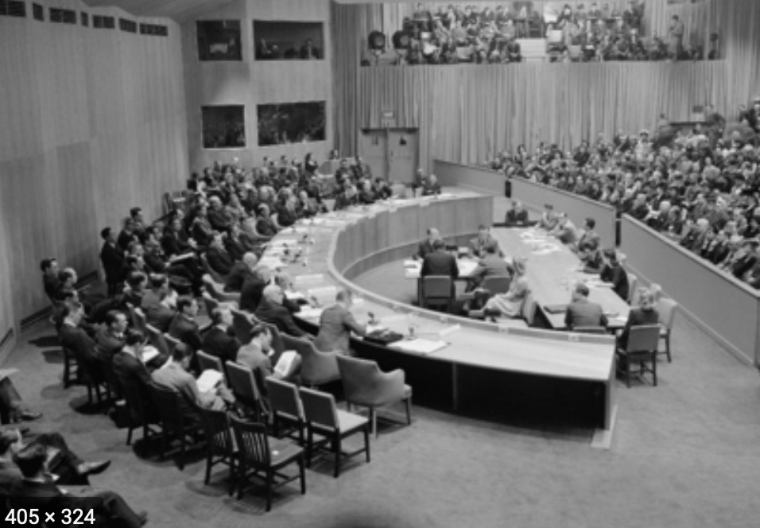
Political Hopes
After World War II the now-dominant United States would not bless colonialism
Social democratic governments rejected the civilizing mission of the colonial empires
And so colonial masters withdrew
The “winds of change” brought independence to Asia and Africa
And with these winds came great hopes for development—and democracy
2:00
Notes:
After World War II the now-dominant United States would not bless, the needs of reconstruction discouraged financing for, and more enlightened left and center-left governments rejected the civilizing mission of the colonial empires. And so Britain, France, and the others withdrew bit by bit. The “winds of change” brought independence to Asia and Africa. And the fall of kings elsewhere sapped the morale of landed elites of Iberian descent in Latin America.
The decolonized in Asia and Africa, and to a lesser extent those now less firmly leashed in Latin America, began with bureaucracies and structures of government typical of the industrial north: representative parliamentary institutions, independent judiciaries, laws establishing freedom of speech and of assembly, and formally apolitical civil service tradition among the bureaucracy. The hope had been that they would then see normal liberal democratic politics: semi-regular alternation in office of parties somewhat to the left and parties somewhat to the right of some sober centrist center of gravity of median voter preferences. The hope had been that, freed from the oppressive controlling hand of colonial rule our landed aristocracy, democracy in the newly-independent former colonies was thought likely to flourish.
And the hope had been that, since their economies would no longer be controlled in the interests of imperial authority or local landed aristocracy, economic prosperity would follow as well. They could now build the railroads, canals and ports; charter the banks for commerce and investment; establish mass education; and impose judicious tariffs to nurture the creation of the communities of engineering practice in those modern industries in which their long-run comparative advantage lay
But it was not to be.

Slide 25
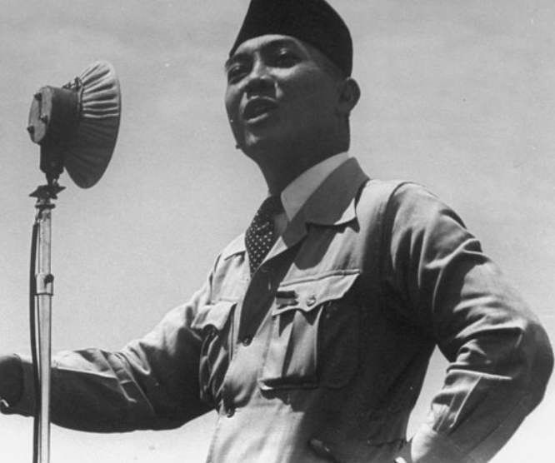
Political Realities
Westminster-style parliamentary politics and independent judiciaries soon became rare exceptions
Found only in India (a very important exception indeed) and a few others
Regimes emerged that derived their authority from”
The army and the police suppressing dissent
From populist attachment to a charismatic nation-symbolizing reforming leader
From a cohesive ethnic group that hung together lest they hang separately
1:40
Notes:
In much of the global south, the political aftermath of decolonization turned out to be a long-run disappointment. Westminster-style parliamentary politics and independent judiciaries soon became rare exceptions: found only in India (a very important exception indeed) and a few others. Instead, regimes emerged that derived their authority not from electoral competition between different groups of possible representatives but from the army and the police suppressing dissent with a varying level of brutality, or—in the best case—from populist attachment to a charismatic nation-symbolizing reforming leader. It would take generations after decolonization for the democratic tide to shift from ebb to flood.
The speed with which political democracy collapsed throughout much of the newly-decolonized third world was disheartening. It suggested that the institutions and practices that keep representative political democracy functioning throughout so much of the industrial core were much more fragile, vulnerable, and contingent than triumphalists would wish. But there was no historical reason to suppose that representative democracy and liberal freedom were the wave of the future. The country of Goethe and Schiller could not maintain them by itself, after all. And the democratizing phase of the great French Revolution had lasted for only four years. Why should anyone expect elsewhere to be different? Rather, be impressed by India, which with great tenacity maintained its hold on parliamentary democracy.

Slide 26
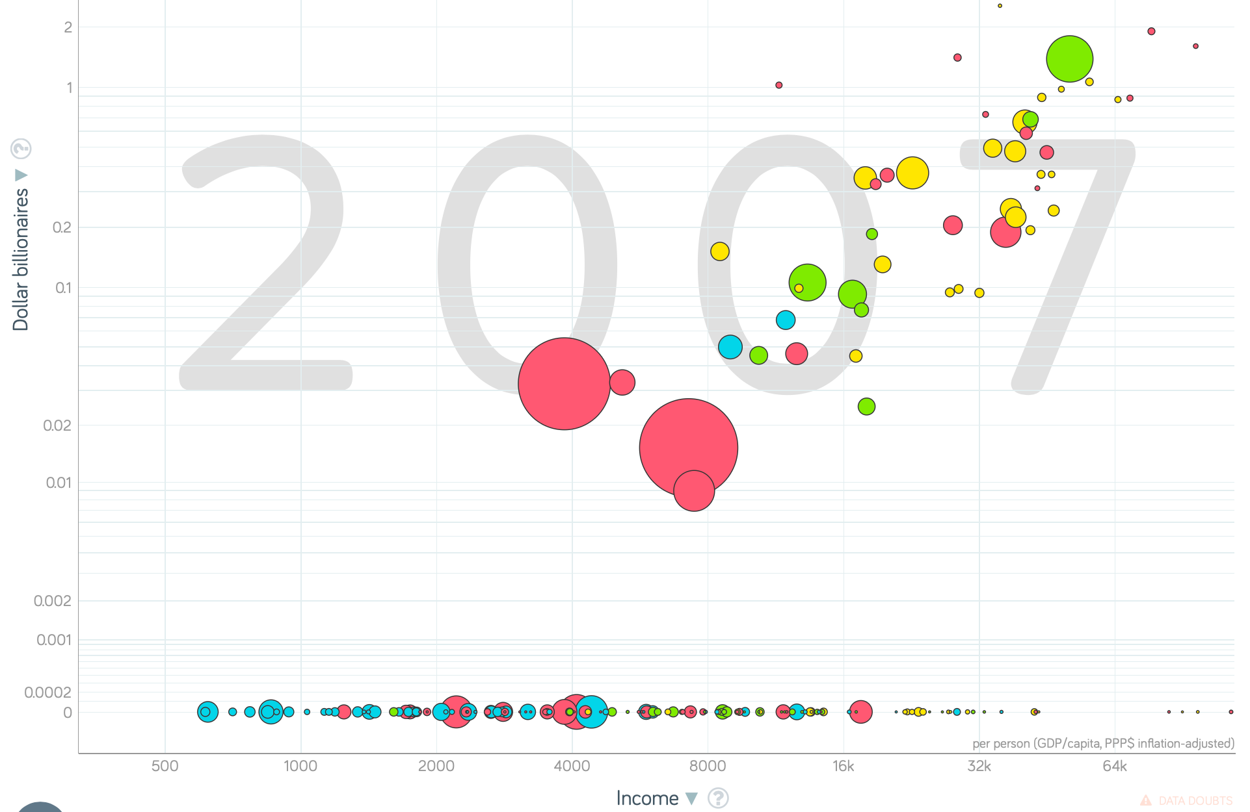
Economic Growth Realities
From a center-of-gravity of $3.50 a day as a living standard in 1950 to $6 or so a day in 1975,
The global south did grow
But it did not catch up
That widening stopped after 1975.
Since 1975, convergence for people
But since 1975, stasis for nation-states
Africa has fallen way, way behind
Perhaps most discouraging was the relative fall in the generation after independence of export crops
What went wrong?
The storehouse of industrial technologies developed since the industrial revolution is open
Many emerging markets that had seemed well on the escalator to modernity in 1950 or 1975 have failed of their promise.
A broadly richer world, yes.
A world much more integrated, yes.
But not convergence on the nation-state level
4:30
Notes:
From a center-of-gravity of $3.50 a day as a living standard in 1950 to $6 or so a day in 1975, the global south did grow in the thirty glorious years of the post-World War II social-democratic boom in the global north. But it did not catch up: the gap vis-a-vis the global north grew to 10 to 1. It was true that Iran, Iraq, Turkey, Syria, Lebanon; Mexico and Brazil; and South Africa appeared on the edge of the global north. Less-oppressive modern dictatorships produced rapid and impressive economic growth in the non-Communist fringe of Paciﬁc Asia, and in Saharan Africa. But elsewhere there was a widening of the relative income gap vis-à-vis the global north.
That widening stopped after 1975. From a global south income-level center-of-gravity of $6 a day in 1975 to $10 a day in 1990 to $15 a day (for the global south excluding China), and with China now at more than $30 a day, there has not for more than a generation been a continuing trend of widening global inequality.
However, Latin America lost a decade of development in the 1980s. Most of those for whom there were great hopes have disappointed: in Latin America today, only Chile and Panama are better-off then China; in Africa, only Botswana; in Asia, only Japan, the Four Tigers—Korea, Taiwan, Hong Kong, and Singapore—Malaysia, and Thailand; and in Latin America, only Chile (with Mexico, Costa Rica, and Brazil equal to) still exceeds China. And the gap between China and the global north is still a factor of 3.5 to 1 or so.
And Africa has fallen way, way behind: South Africa, Kenya, Zambia, Ghana, and Nigeria—all those for which there were great hopes for economic development into the 1960s have failed of their promise. And of the thirty poorest economies in the world today, only four—North Korea, Timor-Leste, Afghanistan, and Haiti—are outside Africa. Benin, Mali, Zimbabwe, Rwanda, Chad, South Sudan, Uganda, Ethiopia, Burkina Faso, the Gambia, Guinea-Bissau, Sierra Leone, Togo, Madagascar, Guinea, Eritrea, Mozambique, Malawi, Niger, Liberia, the DRC, Burundi, the CAR, and Somalia are the places where half or more of the population live lives not that distinguishable from those of our pre-industrial ancestors.
Perhaps most discouraging in Africa was the relatively rapid fall in the generation after independence of the production and exports of crops that had been the staples of African exports. As Robert Bates wrote as early as the start of the 1980s: “Palm oil in Nigeria, groundnuts in Senegal, cotton in Uganda, and cocoa in Ghana were one among the most prosperous industries in Africa. But in recent years, farmers of these crops have produced less, exported less, and earned less…” The only continent in which farmers still perhaps made up a plurality of the workforce was spending an ever-increasing portion of its export earnings on imported food. What went wrong? The storehouse of industrial technologies developed since the industrial revolution is open to all. The forms of knowledge and technologies that make the industrial west today so rich are public goods. The beneﬁts from tapping this storehouse are enormous, and have the potential to multiply the wealth of all social groups and classes—property owners and non-property owners, politically powerful and politically powerless alike—manyfold. All developing economies ought to have experienced not just substantial growth in absolute living standards and productivity levels, but ought to have closed some of the relative gap vis-a-vis the world’s industrial leaders since independence. Yet most emerging markets that had seemed well on the escalator to modernity in 1950 or 1975 have failed of their promise. A broadly richer world than in 1950, yes. A world much more integrated in terms of trade, technology, and the networks that are our value chains, yes. But not a more equal world—even if, since 1975, the trend toward increasing global economy has ended.

Slide 27
Review: Broad Sweep
What was the growth rate of ideas in the industrial core of the world economy over 1870-2020?
About 2.3%/year
About 0.9%/year
About 0.23%/year
About 4%/year
None of the above

Slide 28
Review: Broad Sweep
What was the growth rate of ideas in the industrial core of the world economy over 1770-1870?
About 2.1%/year
About 0.45%/year
About 0.15%/year
About 0.04%/year
None of the above

Slide 29


Kleptocracy
One short and too-simple answer is that the fault—where there is fault—lies in governments: kleptocracy
In a historical perspective kleptocracy—rule by the thieves—is nothing new
It is, rather, the rule
Most governments at most times in most places have followed policies that show little interest in nurturing sustained increases in productivity.
Why should we expect modern emerging markets to be different?
We would expect that governments would take great care to prevent food riots in the capital (and they do)
We would expect that governments would follow the advice of the Roman Emperor Septimius Severus and keep the army well-fed, well-paid, and equipped with lots of new weapons to play with (and they do).
Where government is stable and secure enough that it does not require draining resources from the rest of society to maintain its politicians in office and provide order for its supporters, then economic growth can take place
It can even be encouraged and accelerated by a developmental state…
2:26
Notes:
One short and too-simple answer is that the fault—where there is fault—lies in governments: kleptocracy—govenment by the thieves, as it has been named in analogy with aristocracy (goverment by the best), monarchy (goverment by the one), and democracy (government by the people)—has impoverished much of the third world over the past generation.
Yet in a historical perspective kleptocracy—rule by the thieves—is nothing new. Perhaps the major drawback to the invention of agriculture was that you had to be around to harvest the fields that you had planted. This meant that you could not run away when thugs-with-spears came by to demand the lion’s share of your crops. And as this became generally known, people got into the business of supplying spears for the thugs: we call such people “kings.”
Looking back at human history, it is easy to conclude that most governments at most times in most places have followed policies that show little interest in nurturing sustained increases in productivity. Why should we expect the modern Third World to be any different? We would expect that governments would take great care to prevent food riots in the capital (and they do), and would follow the advice of the Roman Emperor Septimius Severus and keep the army well-fed, well-paid, and equipped with lots of new weapons to play with (and they do). But the lifespan of the average government is too short to expect it to take a serious interest in the project of long-run economic development.
Where government is stable and secure enough that it does not require draining resources from the rest of society to maintain its politicians in office and provide order for its supporters, then economic growth can take place—and can even be encouraged and accelerated by a developmental state, both because most rulers would be benevolent if they thought they could, and because increasing prosperity can be a powerful source of increased stability and security.
This is the short answer.

Slide 30
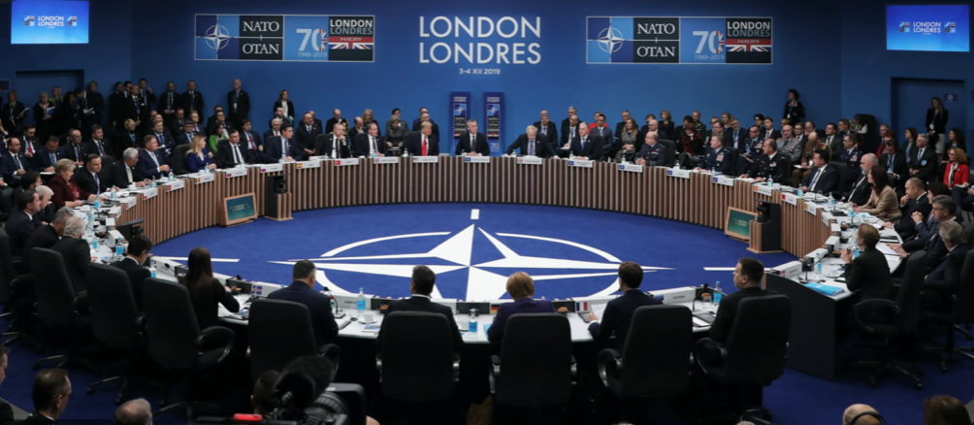

State-Building
Clashes between the logic of economic development on the one hand and the logic of political effectiveness on the other are much stronger when a government and a political order are new or shaky
Too many intellectuals on all sides applauded the strength of the state
The usually-reliable John Hall:
“Forced development is socially brutal. Such development cannot be achieved under the ægis of soft political rule, and this means that the chances of a transition to democracy are correspondingly at a discount. Modernization, under whatever politicial ægis, involves at least disciplining the peasantry and at most forcibly removing it from the land. the removel of tribalism, the destruction of rival cultures, the creation of a lingua franca, and the establishment of national bureaucracies. Third World countries have learnt with time that successful modernization is impeded by democracy. For people do not easily accept the loss of their land and of their customary ways of life: this requires force [and] a totalizing ideology…”
But development need not be “forced”
4:30
Notes:
17.2.2: State-Building
These possible clashes between the logic of economic development on the one hand and the logic of political effectiveness on the other are much stronger when a government and a political order are new or shaky than when they are old and established.
Throughout the post-World War II period intellectuals on all sides applauded the strength of the state, on the ground that only a strong state could perform the historical tasks necessary for economic development. As one usually clear-eyed observer, the political scientist John Hall, put it:
>forced development is socially brutal. Such development cannot be achieved under the ægis of soft political rule, and this means that the chances of a transition to democracy are correspondingly at a discount. Modernization, under whatever politicial ægis, involves at least disciplining the peasantry and at most forcibly removing it from the land. The removel of tribalism, the destruction of rival cultures, the creation of a lingua franca, and the establishment of national bureaucracies. Third World countries have learnt with time that successful modernization is impeded by democracy. For people do not easily accept the loss of their land and of their customary ways of life: this requires force [and] a totalizing ideology…
Now if you look at the successful economic developers of either the nineteenth or the twentieth centuries, you can see that this thinking is fuzzy. Successful development does not require “disciplining the peasantry” or “forcibly removing it from the land.” Successful development requires luring the peasantry off the land to higher-wage higher-productivity factory and commercial jobs in the growing cities. The prevalence of the belief that modernization “under whatever political aegis” is socially brutal rejects as a model for development the experience of the United States, France, Italy, Belgium, Japan, Taiwan, South Korea, and others and accepts as a model for development the Soviet Union of the 1930s: Stalin.
But it is fuzzy thinking that has made a—disastrous—difference.
For one thing, building and strengthening a state is a task that requires both the government’s attention and the government’s resources. Governments and states that wish to be strong need to reward their friends so that they will remain its friends, and to attract more friends. Governments and states that wish to be strong need to make it imprudent to become their enemies. Accomplishing this requires moving resources around: taking from some and granting to others. And if the some that the government takes from are those whose entrepreneurial abilities would have powered the next generation of economic growth? And if those whose entrepreneurship might have been devoted to boosting growth turn instead to figuring out how to profit from becoming friends of the state? Then growth suffers.
What is wanted to support successful economic development is a government strong but limited: strong in the sense that its judgments of property rights are obeyed, that its functionaries obey instructions from the center, and that the infrastructure it pays for is built; limited in the sense that it can do relatively little to help or hurt individual enterprises, and that political power is not the only effective road to wealth and status. And, in addition, it needs to be strong enough to steamroll over local and other notables whenever their interest is strongly opposed to that of economic growth.
This is a narrow tightrope to walk. Walking it may not be possible. Walking it is not possible when attempts at “statebuilding”, as they often have since World War II, aimed at a state that is strong and not limited—and have sometimes wound up with a state that is weak but unlimited: political power is the only effective road to wealth, but functionaries ignore instructions and extort bribes for administrative favors and the infrastructure that it pays for is not built.

Slide 31
Iran Under the Pahlavis—and After
Could things have been much better?
Dilemmas of Iranian development?
The “White Revolution”
Ayatollah Khomeini
A subsequent religious-ideological government
Not interested in economic development
Interested in paradise, not utopia
Oil money has kept Iran and its regime afloat
But convergence and development? Nah.
6:15
Notes:
Iran Under the Pahlavi Shah: A Case
Could things have been much better in the post-World War II periphery in the first generation? The case of the Iranian Revolution suggests that in some cases at least the answer is “no.” For the reasons that the Shah of Iran was overthrown, and Iranian industrialization brought to a near halt, in 1979 had relatively little to do with the faults of the then-Shah (which were many), but had much to do with obstacles to successful economic development. The pre-1979 Imperial Iranian government was a tyranny. It had a ﬁerce and dreaded secret police. It used revenues from sales of government-owned oil to build up an impressive and powerful military. But these were not the reasons that the Shah was overthrown. The Shah hoped to use the bulk of oil revenues to turn Iran into an industrial country in one generation. This meant, ﬁrst, land reform: distribute land to turn tenants and sharecroppers into independent farmers, and compensate landlords with government oil revenues. But rapid population growth and a desire not to offend rich landlords too much meant that the plots distributed were small. The boom in oil exports and the rise in oil prices together pushed up Iran’s exchange rate by a wide margin: and with an overvalued exchange rate, it became proﬁtable to import food. So newly-propertied peasant farmers found themselves with small plots and facing declining prices for what they sold.
They were supposed to become bulwarks of the regime, grateful to it for distributing land. Instead, they scratched what they saw as an inadequate living off of too-small plots, or moved to the cities. While a large share of the Iranian population saw their incomes growing rapidly in the years leading up to 1979, a large share of the Iranian population did not.
Moreover, as the world became smaller with transportation and communications, the people of Iran could see further into what was happening in other countries. For one thing, Russians and Britons and Americans were showing up—rich and arrogant. Iranians had been used to seeing themselves at the center of an Islamic civilization that had been preeminent among world civilizations for more than a millennium. Indeed, less than three centuries separate the joint Anglo-American-Russian occupation of Iran during World War II (in order to provide a logistical aid channel to the Soviet Union) from the days when the Islamic princes of Turkey and the Ganges Valley were besieging Vienna and overrunning the British East India company’s bases in Bengal.
How were people to make sense of such a world? Steps to emancipate women proved unpopular among traditional inﬂuence makers as well. Steps to boost education-and the Shah was truly and genuinely committed to turning Iran into a literate, educated, technologically-proﬁcient country-also produced a large body of students and intellectuals attracted to revolutionary politics. The Shah’s answer was to turn Iranians into Europeans—to follow an authoritarian state-led development road reminiscent of Japan, and earlier Germany. But this left no place for Islam. And it was highly corrupt. From exile, the Ayatollah Khomeini—a former opponent of land reform, who had thought it was un-Islamic to dispossess landlords and free peasants from debt bondage—lit the fuse, calling on the Islamic clergy and the people to seize power from the despot and make an Islamic revolution. A forty-day cycle of demonstrations began, during which young religious activists would be shot by the police, thus triggering another demonstration forty days hence to mourn their deaths. In January 1979 the Shah ﬂed into exile. Thereafter Iran’s economy stagnated. Iran today looks to be no richer than it was in 1977. First a decade-long war with Iraq absorbed tremendous resources. Then the newly-dominant religious government had little interest in economic development: they were interested in paradise in heaven, not in utopia here on earth: the Iranian people had not made the Islamic Revolution to lower the price of watermelons.
----
17.3: Ideological Damage
17.3.1: Damage from Ideologies of the Right
The ideologies of the right did enormous damage to prospects for successful economic development in the first half of the twentieth century. Colonialism itself almost inevitably came with an ideology that the natives were unfit: unfit to rule themselves, unfit to handle complicated machinery, unfit (with a few exceptions) for sophisticated education, unfit to do much of anything other than work on plantations and staff s

Slide 32


Ideological Damage
Ideologies were poisonous
On the right
Colonialism
Austerity
Reactions to failed bets on globalization
On the left
Marx’s fear of markets
But centrally planning will inevitably be very inefficient
And very corrupt
Threading the needle is hard
How has China managed?
6:30
Notes:
The ideologies of the right did enormous damage to prospects for successful economic development in the first half of the twentieth century. Colonialism itself almost inevitably came with an ideology that the natives were unfit: unfit to rule themselves, unfit to handle complicated machinery, unfit (with a few exceptions) for sophisticated education, unfit to do much of anything other than work on plantations and staff small shops.
The ideologies of the right did further damage to the extent that they caused, deepened, and prolonged the Great Depression. The idea that the only good economy was a gold standard economy helped start the Depression. The idea that a recession had a positive, long-run, social-darwinian effect on the economy helped deepen and prolong the Great Depression. And the fact that integration into the global economy caused large-scale economic disaster during the 1930s taught many governments in the 1940s and 1950s that they should avoid integration into the global economy: strategies of neo-autarky and import-substitution development that were fashionable in the 1950s, and that were by and large unsuccessful, had their roots in an overlearning of the lessons of the Great Depression.
17.3.2: Damage from Ideologies of the Left
If ideologies of the right did massive damage to prospects for economic development before 1950, ideologies of the left did massive damage to prospects for development since 1950. Newly-independent decolonized governments in the 1950s and 1960s listened to intellectuals from the left because the left had been anti-colonial—while the center and the right were, before World War II, imperialist. Thus the Indian National Congress would look to the British Labour Party—their friends in Britain—for advice on how to create the preconditions for successful economic growth. And left wing political opinions throughout most of the twentieth century have been at least somewhat friendly toward really-existing socialism. And that friendliness carried with it Marx’s doctrine that markets are evil in their essence— hence anything that replaced markets must be good. This had a very large influence on third world development policy in the first post-WWII generation. The tying of left wing commitments ﬁrst to the really-existing socialist Leninist-Stalinist régime established in Russia after the Bolshevik Revolution, and then to the successor régimes that emerged from decolonization did harm to the political left as a moral entity. Marx had looked forward to immense material wealth evenly distributed, to freedom of occupational and residential choice, to representative governments, to free speech and free association. But the really-existing socialist governments that the political left found itself associated with—the products of the Bolshevik revolution and of decolonization—had relatively little of these. The commitment to representative government was the ﬁrst commitment the political left threw overboard: only an educated and informed electorate could exercise its right to vote, and until such an educated and informed socialist electorate could be created, a centralized party was necessary in its place. To rank representative institutions high on any list of the criteria of a good society was, it was mistakenly thought, implicitly to attack decolonization and to defend the late colonial order. The commitment to free speech and free association went next. Nation-building required unity. If politicians and newspapers could whistle different tunes and criticize the government, this would disrupt the fragile unity of new nations. Then advocacy of private economic freedoms disappeared: all of the resources of society had to be mobilized according to a single plan for rapid industrialization.
Thus the left-wing historian E.P. Thompson could write in the 1970s that:
...the Communists of the 1930s and 1940s were not altogether wrong, intellectually or politically. [The] visions [we feared] were of Panzers or of Sherman tanks rolling into the East, breathing racial purity or the freedom of capital down the barrels of their guns...
Put to one side the rhetorical pairing (at the end of the 1960s!) of Franklin Roosevelt and Adolf Hitler: either E.P. Thompson is an idiot, or it is an exaggeration not meant to be taken seriously. Note instead that, in Thompson’s mind, freedom of speech, freedom from arbitrary execution, freedom to elect the government, and material wealth orders of magnitude greater than that produced by Stalin’s bureaucracy—all these piled together—count for little because they come tied to “freedom of capital.” Eggs were broken. The habit of breaking them on whim grew. But no omelet appeared.

Slide 33
Neoliberal Turns and Developmental States
Perhaps the miracle is that there was so much growth…
Chile, Mexico, southern Brazil, and Panama in Latin America
Algeria in Saharan and Botswana in sub-Saharan Africa
Hong Kong, Malaysia, Singapore, South Korea, Taiwan, Thailand, and now, of course, China in Asia
Developmental states where they work
Elsewhere, a neoliberal turn
6:00
Notes:
From a cynical perspective the interesting question might be not why was there economic stagnation in much and absolute economic decline in some ofemerging markets, but why there was rapid growth in other portions. Chile, Mexico, southern Brazil, and Panama in Latin America; Algeria in Saharan and Botswana in sub-Saharan Africa; and Hong Kong, Malaysia, Singapore, South Korea, Taiwan, Thailand, and now, of course, China in Asia are countries that have made impressive strides toward closing the relative material prosperity gap vis-a-vis the global north in the post-World War II era. How have they managed to do this? What have been the key factors separating successful from unsuccessful episodes of economic development?
The natural conclusion from emerging-market history is that successful economic development is difficult without either a limited government or a developmental state: the logic of politics is that of favors performed, wealth redistributed, inﬂuence exercised, and taxes collected; that is very different from the logic of economic growth. Only a state that is limited in the amount of damage it can do to the economy, or a state that is secure enough, independent enough, and committed to rapid economic growth can avoid this development trap.
These are the two roads to successful rapid development: “neoliberalism,” on the one hand; and the so-called “developmental state” approach that has been so successful in East Asia on the other. Either insulate the economy from the (semi-predatory) government so that the government’s attempts to tilt the distribution of income in favor of the politically powerful are relatively ineffective and do little harm, or create a government bureaucracy whose first goal is development, and which views interests as its tools to be used in promoting economic growth, rather than as its masters.
These pressures have, in the post-World War II period at least, been strong enough to counteract the natural tendency for poor countries to learn rapidly about technology and catch up to rich ones. There is no clear reason on the horizon for these pressures to diminish. Optimists hope that the record of economic failure provided by much third world experience in the past generation will lead to the creation of intellectual pressures for reform strong enough to overcome the bias for stagnation. And if ideas truly are the decisive forces making history in the long run, perhaps the optimists are right.
If the optimists are wrong, then we are all in big trouble. Successful handling of the future’s global environmental problems, and successful long-run stabilization of human populations, hinges on successful industrialization in the third world and the consequent—rapid—passage through the demographic transition.
----
One way to read the economic history is as repeated attempts to produce the second: to create a pro-growth “developmental state.” Yet in the last analysis there is nothing worse than state-led development led by an anti-developmental state. And that was what too many post-independence Asian and African and too many post-World War II Latin American states turned out to be.
Thus starting in the 1980s hopes for development—outside of the Pacific Rim, where the successful “developmental state” has been was already clearly a reality— shifted in the direction of “neoliberalism.” It seemed better to try to limit the state’s involvement in the process of development, because its interventions were more likely to be destructive than constructive. Rely, instead, on the world market as a source of demand, and on the requirements for integration into the world market and cooperation with the international agencies set up after World War II as a source of good-enough governance.

Slide 34
Big Ideas: Lecture 17: the Development of Underdevelopment
Takeaways from this class:

Slide 35
Roadmap for the Next Two Weeks…
17. Tu Mar 31: 4.6. The Development of Underdevelopment
Read After: W. Arthur Lewis (1978): Evolution of the International Economic Order <https://delong.typepad.com/sdj/2008/04/w-arthur-lewis.html>
Slides: <https://github.com/braddelong/public-files/blob/master/econ-135-lecture-17.pptx>
18. Th Apr 2: Touring the Continents: 5.1. Western Europe, North America, and South America
Read Before: Joel Mokyr (1990): Lever of Riches, chapter 10 Britain and Europe <https://delong.typepad.com/files/mokyr-lever-europe.pdf>
Read Before: John Coatsworth (2008).: Inequality, Institutions and Economic Growth in Latin America <https://delong.typepad.com/files/coatsworth-institutions.pdf>
Slides: <https://github.com/braddelong/public-files/blob/master/econ-135-lecture-18.pptx>
19. Tu Apr 7: 5.2. Behind the Iron Curtain, and East Asian Miracles
Read Before: Peter Evans (1995): Embedded Autonomy: States and Industrial Transformation, chapter 1 <https://delong.typepad.com/files/evans-embedded-i.pdf>
Read Before: Yingyi Qian (2001): How Reform Worked in China <https://delong.typepad.com/files/qian-reform.pdf>
Read Before: Richard Ericson (1991): The Classical Soviet-Type Economy: Nature of the System and Implications for Reform <https://delong.typepad.com/files/ericson-soviet.pdf>
Slides: <https://github.com/braddelong/public-files/blob/master/econ-135-lecture-19.pptx>
20. Th Apr 9: 5.3. Asia and Africa
Read Before: Nathan Nunn (2008): The Long Term Effects of Africa's Slave Trades <https://dash.harvard.edu/bitstream/handle/1/3710252/Nunn_Long-TermEffects.pdf>
Read After: Sevkut Pamuk (2014): Institutional Change and Economic Development in the Middle East, 700-1800 <https://delong.typepad.com/files/pamuk.pdf>
Slides: <https://github.com/braddelong/public-files/blob/master/econ-135-lecture-20.pptx>

Slide 36
Roadmap Following: 6. Policy Issues…
6. Policy Issues
T Apr 14: 6.1. "Deep Roots" vs. Path Dependence
Read Before: Nathan Nunn (2012): Culture and the Historical Process <https://delong.typepad.com/files/nunn-culture.pdf>
Read Before: Melissa Dell (2015): Path Dependence in Development: Evidence from the Mexican Revolution <https://scholar.harvard.edu/files/dell/files/revolutiondraft.pdf>
Th Apr 16: 6.2. Growth and Fluctuations; Trade and Development, Foreign Aid
Read After: Barry Eichengreen (2015): Hall of Mirrors: The Great Depression, The Great Recession, and the Uses-and Misuses-of History, selections <https://delong.typepad.com/files/eichengreen-mirrors.pdf>
Read After: David Atkin (2014): Endogenous Skill Acquisition and Export Manufacturing in Mexico <https://delong.typepad.com/files/atkin-skill.pdf>
T Apr 21: 6.3. Populism, Plutocracy, Kleptocracy, & Neo-Fascism
Read Before: Ernest Gellner (1973): Nations & Nationalism, selections <https://delong.typepad.com/files/gellner- nations.pdf>
Read Before: Barry Eichengreen (2018): The Populist Temptation Economic Grievance & Political Reaction in the Modern Era, selections <https://delong.typepad.com/files/eichengeeen-populist.pdf >
Th Apr 23: 6.4. Global Warming
Read After: Melissa Dell et al. (2012): Temperature Shocks & Economic Growth: Evidence from the Last Half Century <https://scholar.harvard.edu/files/dell/files/aej_temperature.pdf>
Read After: Melissa Dell et al. (2014). What Do We Learn from the Weather? The New Climate-Economy Literature, selections <https://economics.mit.edu/files/9138>
T Apr 28: 6.5. The Pace and Meaning of Economic Growth
Read Before: William Nordhaus: Do Real-Output and Real-Wage Measures Capture Reality? <https://www.nber.org/chapters/c6064.pdf>
Read Before: John Maynard Keynes: Economic Possibilities for Our Grandchildren<<https://delong.typepad.com/files/keynes-persuasion.pdf>
Read Before: Edward Bellamy (1887): Looking Backward 2000-1887, selections <https://delong.typepad.com/files/bellamy-backward.pdf>

Slide 37
Roadmap Following: 7. Conclusion…
7. Conclusion
Th Apr 30: 7. Conclusion: The Future?
Read After: Robert Allen (2011): Global Economic History: A Very Short Introduction, selections <https://delong.typepad.com/files/allen-geh.pdf >
W May 13 11:30-14:30: FINAL PAPER/PROJECT DUE

Slide 38
Catch Our Breath…
Ask a couple of questions?
Make a couple of comments?
Any more readings to recommend?

Slide 39
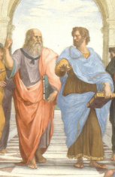
Notes, etc.…

